Slide 1

Greedy Approach
Design and Analysis of
Algorithms

Slide 2
Greedy Approach
A Greedy Approach obtains an optimal solution by making a sequence of choices.
-- A Greedy algorithm always makes the choice that looks best at the
moment.
-- it makes a locally optimal choice in the hope that this choice will lead to
a globally optimal solution

Slide 3
Greedy Approach
Greedy algorithms do not always yield optimal solution.
-- Fractional Knapsack
-- Minimum Spanning Trees-Prim and Kruskal
-- Single source shortest paths- Dijkstra and Bellman ford
-- Convex Hull and Searching
-- Activity selection problem
-- Designing data compression codes (Huffman)

Slide 4
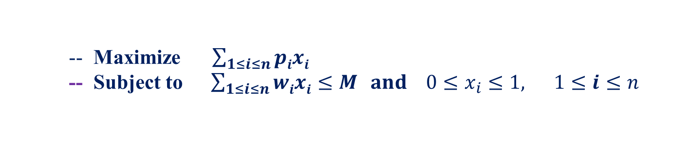
Fractional Knapsack Problem
-- Maximize $\sum_{1≤i≤n}{pixi}$
-- Subject to $\sum_{1≤i≤n}{wixi≤M} and 0≤x_{i}≤1, 1≤ⅈ≤n$

Slide 5
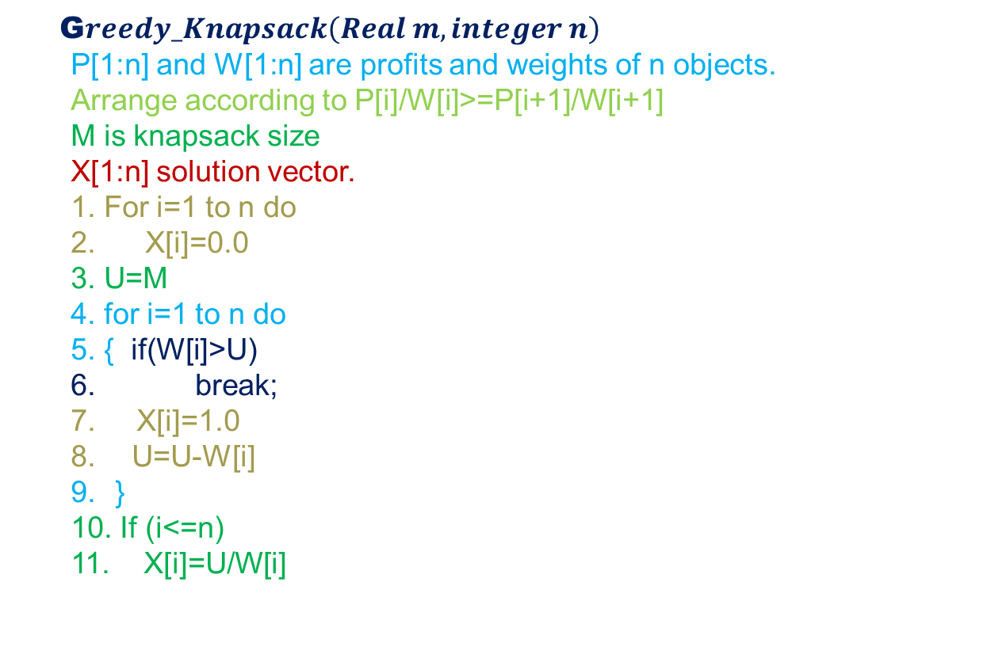
Fractional Knapsack Problem
G$reedy_Knapsack\left(Real m, integer n\right)$
P[1:n] and W[1:n] are profits and weights of n objects.
Arrange according to P[i]/W[i]>=P[i+1]/W[i+1]
M is knapsack size
X[1:n] solution vector.
1. For i=1 to n do
2. X[i]=0.0
3. U=M
4. for i=1 to n do
5. { if(W[i]>U)
6. break;
7. X[i]=1.0
U=U-W[i]
}
10. If (i<=n)
11. X[i]=U/W[i]

Slide 6
Fractional Knapsack Problem
G$reedy_Knapsack\left(Real m, integer n\right)$
P[1:n] and W[1:n] are profits and weights of n objects.
Arrange according to P[i]/W[i]>=P[i+1]/W[i+1]
M is knapsack size
X[1:n] solution vector.
1. For i=1 to n do
2. X[i]=0.0
3. U=M
4. for i=1 to n do
5. { if(W[i]>U)
6. break;
7. X[i]=1.0
U=U-W[i]
}
10. If (i<=n)
11. X[i]=U/W[i]
Pi
30 | 40 | 45 | 77 | 90
Wi
5 | 10 | 15 | 22 | 25
Pi/Wi
6 | 4 | 3 | 3.5 | 3.6

Slide 7
Fractional Knapsack Problem
G$reedy_Knapsack\left(Real m, integer n\right)$
P[1:n] and W[1:n] are profits and weights of n objects.
Arrange according to P[i]/W[i]>=P[i+1]/W[i+1]
M is knapsack size
X[1:n] solution vector.
1. For i=1 to n do
2. X[i]=0.0
3. U=M
4. for i=1 to n do
5. { if(W[i]>U)
6. break;
7. X[i]=1.0
U=U-W[i]
}
10. If (i<=n)
11. X[i]=U/W[i]
Pi
30 | 40 | 45 | 77 | 90
Wi
5 | 10 | 15 | 22 | 25
Pi/Wi
6 | 4 | 3 | 3.5 | 3.6
Pi
30
Wi
5
Pi/Wi
6

Slide 8
Fractional Knapsack Problem
G$reedy_Knapsack\left(Real m, integer n\right)$
P[1:n] and W[1:n] are profits and weights of n objects.
Arrange according to P[i]/W[i]>=P[i+1]/W[i+1]
M is knapsack size
X[1:n] solution vector.
1. For i=1 to n do
2. X[i]=0.0
3. U=M
4. for i=1 to n do
5. { if(W[i]>U)
6. break;
7. X[i]=1.0
U=U-W[i]
}
10. If (i<=n)
11. X[i]=U/W[i]
Pi
30 | 40 | 45 | 77 | 90
Wi
5 | 10 | 15 | 22 | 25
Pi/Wi
6 | 4 | 3 | 3.5 | 3.6
Pi
30 | 40
Wi
5 | 10
Pi/Wi
6 | 4

Slide 9
Fractional Knapsack Problem
G$reedy_Knapsack\left(Real m, integer n\right)$
P[1:n] and W[1:n] are profits and weights of n objects.
Arrange according to P[i]/W[i]>=P[i+1]/W[i+1]
M is knapsack size
X[1:n] solution vector.
1. For i=1 to n do
2. X[i]=0.0
3. U=M
4. for i=1 to n do
5. { if(W[i]>U)
6. break;
7. X[i]=1.0
U=U-W[i]
}
10. If (i<=n)
11. X[i]=U/W[i]
Pi
30 | 40 | 45 | 77 | 90
Wi
5 | 10 | 15 | 22 | 25
Pi/Wi
6 | 4 | 3 | 3.5 | 3.6
Pi
30 | 40 | 90
Wi
5 | 10 | 25
Pi/Wi
6 | 4 | 3.6

Slide 10
Fractional Knapsack Problem
G$reedy_Knapsack\left(Real m, integer n\right)$
P[1:n] and W[1:n] are profits and weights of n objects.
Arrange according to P[i]/W[i]>=P[i+1]/W[i+1]
M is knapsack size
X[1:n] solution vector.
1. For i=1 to n do
2. X[i]=0.0
3. U=M
4. for i=1 to n do
5. { if(W[i]>U)
6. break;
7. X[i]=1.0
U=U-W[i]
}
10. If (i<=n)
11. X[i]=U/W[i]
Pi
30 | 40 | 45 | 77 | 90
Wi
5 | 10 | 15 | 22 | 25
Pi/Wi
6 | 4 | 3 | 3.5 | 3.6
Pi
30 | 40 | 90 | 77
Wi
5 | 10 | 25 | 22
Pi/Wi
6 | 4 | 3.6 | 3.5

Slide 11
Fractional Knapsack Problem
G$reedy_Knapsack\left(Real m, integer n\right)$
P[1:n] and W[1:n] are profits and weights of n objects.
Arrange according to P[i]/W[i]>=P[i+1]/W[i+1]
M is knapsack size
X[1:n] solution vector.
1. For i=1 to n do
2. X[i]=0.0
3. U=M
4. for i=1 to n do
5. { if(W[i]>U)
6. break;
7. X[i]=1.0
U=U-W[i]
}
10. If (i<=n)
11. X[i]=U/W[i]
Pi
30 | 40 | 45 | 77 | 90
Wi
5 | 10 | 15 | 22 | 25
Pi/Wi
6 | 4 | 3 | 3.5 | 3.6
Pi
30 | 40 | 90 | 77 | 45
Wi
5 | 10 | 25 | 22 | 15
Pi/Wi
6 | 4 | 3.6 | 3.5 | 3

Slide 12
Fractional Knapsack Problem
G$reedy_Knapsack\left(Real m, integer n\right)$
P[1:n] and W[1:n] are profits and weights of n objects.
Arrange according to P[i]/W[i]>=P[i+1]/W[i+1]
M is knapsack size
X[1:n] solution vector.
1. For i=1 to n do
2. X[i]=0.0
3. U=M
4. for i=1 to n do
5. { if(W[i]>U)
6. break;
7. X[i]=1.0
U=U-W[i]
}
10. If (i<=n)
11. X[i]=U/W[i]
Pi
30 | 40 | 90 | 77 | 45
Wi
5 | 10 | 25 | 22 | 15
Pi/Wi
6 | 4 | 3.6 | 3.5 | 3
M=60

Slide 13
Fractional Knapsack Problem
G$reedy_Knapsack\left(Real m, integer n\right)$
P[1:n] and W[1:n] are profits and weights of n objects.
Arrange according to P[i]/W[i]>=P[i+1]/W[i+1]
M is knapsack size
X[1:n] solution vector.
1. For i=1 to n do
2. X[i]=0.0
3. U=M
4. for i=1 to n do
5. { if(W[i]>U)
6. break;
7. X[i]=1.0
U=U-W[i]
}
10. If (i<=n)
11. X[i]=U/W[i]
Pi
30 | 40 | 90 | 77 | 45
Wi
5 | 10 | 25 | 22 | 15
Pi/Wi
6 | 4 | 3.6 | 3.5 | 3
M=60
Xi
0.0 | 0.0 | 0.0 | 0.0 | 0.0

Slide 14
Fractional Knapsack Problem
G$reedy_Knapsack\left(Real m, integer n\right)$
P[1:n] and W[1:n] are profits and weights of n objects.
Arrange according to P[i]/W[i]>=P[i+1]/W[i+1]
M is knapsack size
X[1:n] solution vector.
1. For i=1 to n do
2. X[i]=0.0
3. U=M
4. for i=1 to n do
5. { if(W[i]>U)
6. break;
7. X[i]=1.0
U=U-W[i]
}
10. If (i<=n)
11. X[i]=U/W[i]
Pi
30 | 40 | 90 | 77 | 45
Wi
5 | 10 | 25 | 22 | 15
Pi/Wi
6 | 4 | 3.6 | 3.5 | 3
M=60
Xi
0.0 | 0.0 | 0.0 | 0.0 | 0.0
U=M

Slide 15
Fractional Knapsack Problem
G$reedy_Knapsack\left(Real m, integer n\right)$
P[1:n] and W[1:n] are profits and weights of n objects.
Arrange according to P[i]/W[i]>=P[i+1]/W[i+1]
M is knapsack size
X[1:n] solution vector.
1. For i=1 to n do
2. X[i]=0.0
3. U=M
4. for i=1 to n do
5. { if(W[i]>U)
6. break;
7. X[i]=1.0
U=U-W[i]
}
10. If (i<=n)
11. X[i]=U/W[i]
Pi
30 | 40 | 90 | 77 | 45
Wi
5 | 10 | 25 | 22 | 15
Pi/Wi
6 | 4 | 3.6 | 3.5 | 3
M=60
Xi
0.0 | 0.0 | 0.0 | 0.0 | 0.0
i=1
U=M

Slide 16
Fractional Knapsack Problem
G$reedy_Knapsack\left(Real m, integer n\right)$
P[1:n] and W[1:n] are profits and weights of n objects.
Arrange according to P[i]/W[i]>=P[i+1]/W[i+1]
M is knapsack size
X[1:n] solution vector.
1. For i=1 to n do
2. X[i]=0.0
3. U=M
4. for i=1 to n do
5. { if(W[i]>U)
6. break;
7. X[i]=1.0
U=U-W[i]
}
10. If (i<=n)
11. X[i]=U/W[i]
Pi
30 | 40 | 90 | 77 | 45
Wi
5 | 10 | 25 | 22 | 15
Pi/Wi
6 | 4 | 3.6 | 3.5 | 3
M=60
Xi
0.0 | 0.0 | 0.0 | 0.0 | 0.0
i=1
U=M
W[1] > U i.e. 5>60

Slide 17
Fractional Knapsack Problem
G$reedy_Knapsack\left(Real m, integer n\right)$
P[1:n] and W[1:n] are profits and weights of n objects.
Arrange according to P[i]/W[i]>=P[i+1]/W[i+1]
M is knapsack size
X[1:n] solution vector.
1. For i=1 to n do
2. X[i]=0.0
3. U=M
4. for i=1 to n do
5. { if(W[i]>U)
6. break;
7. X[i]=1.0
U=U-W[i]
}
10. If (i<=n)
11. X[i]=U/W[i]
Pi
30 | 40 | 90 | 77 | 45
Wi
5 | 10 | 25 | 22 | 15
Pi/Wi
6 | 4 | 3.6 | 3.5 | 3
M=60
Xi
0.0 | 0.0 | 0.0 | 0.0 | 0.0
i=1
U=M
W[1] > U i.e. 5>60 False

Slide 18
Fractional Knapsack Problem
G$reedy_Knapsack\left(Real m, integer n\right)$
P[1:n] and W[1:n] are profits and weights of n objects.
Arrange according to P[i]/W[i]>=P[i+1]/W[i+1]
M is knapsack size
X[1:n] solution vector.
1. For i=1 to n do
2. X[i]=0.0
3. U=M
4. for i=1 to n do
5. { if(W[i]>U)
6. break;
7. X[i]=1.0
U=U-W[i]
}
10. If (i<=n)
11. X[i]=U/W[i]
Pi
30 | 40 | 90 | 77 | 45
Wi
5 | 10 | 25 | 22 | 15
Pi/Wi
6 | 4 | 3.6 | 3.5 | 3
M=60
Xi
0.0 | 0.0 | 0.0 | 0.0 | 0.0
i=1
U=M
W[1] > U i.e. 5>60 False
X[1]=1.0

Slide 19
Fractional Knapsack Problem
G$reedy_Knapsack\left(Real m, integer n\right)$
P[1:n] and W[1:n] are profits and weights of n objects.
Arrange according to P[i]/W[i]>=P[i+1]/W[i+1]
M is knapsack size
X[1:n] solution vector.
1. For i=1 to n do
2. X[i]=0.0
3. U=M
4. for i=1 to n do
5. { if(W[i]>U)
6. break;
7. X[i]=1.0
U=U-W[i]
}
10. If (i<=n)
11. X[i]=U/W[i]
Pi
30 | 40 | 90 | 77 | 45
Wi
5 | 10 | 25 | 22 | 15
Pi/Wi
6 | 4 | 3.6 | 3.5 | 3
M=60
Xi
1.0 | 0.0 | 0.0 | 0.0 | 0.0
i=1
U=M
W[1] > U i.e. 5>60 False
X[1]=1.0

Slide 20
Fractional Knapsack Problem
G$reedy_Knapsack\left(Real m, integer n\right)$
P[1:n] and W[1:n] are profits and weights of n objects.
Arrange according to P[i]/W[i]>=P[i+1]/W[i+1]
M is knapsack size
X[1:n] solution vector.
1. For i=1 to n do
2. X[i]=0.0
3. U=M
4. for i=1 to n do
5. { if(W[i]>U)
6. break;
7. X[i]=1.0
U=U-W[i]
}
10. If (i<=n)
11. X[i]=U/W[i]
Pi
30 | 40 | 90 | 77 | 45
Wi
5 | 10 | 25 | 22 | 15
Pi/Wi
6 | 4 | 3.6 | 3.5 | 3
M=60
Xi
1.0 | 0.0 | 0.0 | 0.0 | 0.0
i=1
U=M
W[1] > U i.e. 5>60 False
X[1]=1.0
U=U-W[1] U=60-5=55

Slide 21
Fractional Knapsack Problem
G$reedy_Knapsack\left(Real m, integer n\right)$
P[1:n] and W[1:n] are profits and weights of n objects.
Arrange according to P[i]/W[i]>=P[i+1]/W[i+1]
M is knapsack size
X[1:n] solution vector.
1. For i=1 to n do
2. X[i]=0.0
3. U=M
4. for i=1 to n do
5. { if(W[i]>U)
6. break;
7. X[i]=1.0
U=U-W[i]
}
10. If (i<=n)
11. X[i]=U/W[i]
Pi
30 | 40 | 90 | 77 | 45
Wi
5 | 10 | 25 | 22 | 15
Pi/Wi
6 | 4 | 3.6 | 3.5 | 3
M=60
Xi
1.0 | 0.0 | 0.0 | 0.0 | 0.0
i=2
U=M

Slide 22
Fractional Knapsack Problem
G$reedy_Knapsack\left(Real m, integer n\right)$
P[1:n] and W[1:n] are profits and weights of n objects.
Arrange according to P[i]/W[i]>=P[i+1]/W[i+1]
M is knapsack size
X[1:n] solution vector.
1. For i=1 to n do
2. X[i]=0.0
3. U=M
4. for i=1 to n do
5. { if(W[i]>U)
6. break;
7. X[i]=1.0
U=U-W[i]
}
10. If (i<=n)
11. X[i]=U/W[i]
Pi
30 | 40 | 90 | 77 | 45
Wi
5 | 10 | 25 | 22 | 15
Pi/Wi
6 | 4 | 3.6 | 3.5 | 3
M=60
Xi
1.0 | 0.0 | 0.0 | 0.0 | 0.0
i=2
U=55
W[2] > U i.e. 10>55 False

Slide 23
Fractional Knapsack Problem
G$reedy_Knapsack\left(Real m, integer n\right)$
P[1:n] and W[1:n] are profits and weights of n objects.
Arrange according to P[i]/W[i]>=P[i+1]/W[i+1]
M is knapsack size
X[1:n] solution vector.
1. For i=1 to n do
2. X[i]=0.0
3. U=M
4. for i=1 to n do
5. { if(W[i]>U)
6. break;
7. X[i]=1.0
U=U-W[i]
}
10. If (i<=n)
11. X[i]=U/W[i]
Pi
30 | 40 | 90 | 77 | 45
Wi
5 | 10 | 25 | 22 | 15
Pi/Wi
6 | 4 | 3.6 | 3.5 | 3
M=60
Xi
1.0 | 1.0 | 0.0 | 0.0 | 0.0
i=2
U=55
W[2] > U i.e. 10>55 False
X[2]=1.0

Slide 24
Fractional Knapsack Problem
G$reedy_Knapsack\left(Real m, integer n\right)$
P[1:n] and W[1:n] are profits and weights of n objects.
Arrange according to P[i]/W[i]>=P[i+1]/W[i+1]
M is knapsack size
X[1:n] solution vector.
1. For i=1 to n do
2. X[i]=0.0
3. U=M
4. for i=1 to n do
5. { if(W[i]>U)
6. break;
7. X[i]=1.0
U=U-W[i]
}
10. If (i<=n)
11. X[i]=U/W[i]
Pi
30 | 40 | 90 | 77 | 45
Wi
5 | 10 | 25 | 22 | 15
Pi/Wi
6 | 4 | 3.6 | 3.5 | 3
M=60
Xi
1.0 | 1.0 | 0.0 | 0.0 | 0.0
i=2
U=55
W[2] > U i.e. 10>55 False
X[2]=1.0
U=U-W[2] U=55-10=45

Slide 25
Fractional Knapsack Problem
G$reedy_Knapsack\left(Real m, integer n\right)$
P[1:n] and W[1:n] are profits and weights of n objects.
Arrange according to P[i]/W[i]>=P[i+1]/W[i+1]
M is knapsack size
X[1:n] solution vector.
1. For i=1 to n do
2. X[i]=0.0
3. U=M
4. for i=1 to n do
5. { if(W[i]>U)
6. break;
7. X[i]=1.0
U=U-W[i]
}
10. If (i<=n)
11. X[i]=U/W[i]
Pi
30 | 40 | 90 | 77 | 45
Wi
5 | 10 | 25 | 22 | 15
Pi/Wi
6 | 4 | 3.6 | 3.5 | 3
M=60
Xi
1.0 | 1.0 | 0.0 | 0.0 | 0.0
i=3
U=45

Slide 26
Fractional Knapsack Problem
G$reedy_Knapsack\left(Real m, integer n\right)$
P[1:n] and W[1:n] are profits and weights of n objects.
Arrange according to P[i]/W[i]>=P[i+1]/W[i+1]
M is knapsack size
X[1:n] solution vector.
1. For i=1 to n do
2. X[i]=0.0
3. U=M
4. for i=1 to n do
5. { if(W[i]>U)
6. break;
7. X[i]=1.0
U=U-W[i]
}
10. If (i<=n)
11. X[i]=U/W[i]
Pi
30 | 40 | 90 | 77 | 45
Wi
5 | 10 | 25 | 22 | 15
Pi/Wi
6 | 4 | 3.6 | 3.5 | 3
M=60
Xi
1.0 | 1.0 | 0.0 | 0.0 | 0.0
i=3
U=45
W[3] > U i.e. 25>45 False

Slide 27
Fractional Knapsack Problem
G$reedy_Knapsack\left(Real m, integer n\right)$
P[1:n] and W[1:n] are profits and weights of n objects.
Arrange according to P[i]/W[i]>=P[i+1]/W[i+1]
M is knapsack size
X[1:n] solution vector.
1. For i=1 to n do
2. X[i]=0.0
3. U=M
4. for i=1 to n do
5. { if(W[i]>U)
6. break;
7. X[i]=1.0
U=U-W[i]
}
10. If (i<=n)
11. X[i]=U/W[i]
Pi
30 | 40 | 90 | 77 | 45
Wi
5 | 10 | 25 | 22 | 15
Pi/Wi
6 | 4 | 3.6 | 3.5 | 3
M=60
Xi
1.0 | 1.0 | 1.0 | 0.0 | 0.0
i=3
U=45
W[3] > U i.e. 25>45 False
X[3]=1.0

Slide 28
Fractional Knapsack Problem
G$reedy_Knapsack\left(Real m, integer n\right)$
P[1:n] and W[1:n] are profits and weights of n objects.
Arrange according to P[i]/W[i]>=P[i+1]/W[i+1]
M is knapsack size
X[1:n] solution vector.
1. For i=1 to n do
2. X[i]=0.0
3. U=M
4. for i=1 to n do
5. { if(W[i]>U)
6. break;
7. X[i]=1.0
U=U-W[i]
}
10. If (i<=n)
11. X[i]=U/W[i]
Pi
30 | 40 | 90 | 77 | 45
Wi
5 | 10 | 25 | 22 | 15
Pi/Wi
6 | 4 | 3.6 | 3.5 | 3
M=60
Xi
1.0 | 1.0 | 1.0 | 0.0 | 0.0
i=3
U=45
W[3] > U i.e. 25>45 False
X[3]=1.0
U=U-W[3] U=45-25=20

Slide 29
Fractional Knapsack Problem
G$reedy_Knapsack\left(Real m, integer n\right)$
P[1:n] and W[1:n] are profits and weights of n objects.
Arrange according to P[i]/W[i]>=P[i+1]/W[i+1]
M is knapsack size
X[1:n] solution vector.
1. For i=1 to n do
2. X[i]=0.0
3. U=M
4. for i=1 to n do
5. { if(W[i]>U)
6. break;
7. X[i]=1.0
U=U-W[i]
}
10. If (i<=n)
11. X[i]=U/W[i]
Pi
30 | 40 | 90 | 77 | 45
Wi
5 | 10 | 25 | 22 | 15
Pi/Wi
6 | 4 | 3.6 | 3.5 | 3
M=60
Xi
1.0 | 1.0 | 1.0 | 0.0 | 0.0
i=4
U=20

Slide 30
Fractional Knapsack Problem
G$reedy_Knapsack\left(Real m, integer n\right)$
P[1:n] and W[1:n] are profits and weights of n objects.
Arrange according to P[i]/W[i]>=P[i+1]/W[i+1]
M is knapsack size
X[1:n] solution vector.
1. For i=1 to n do
2. X[i]=0.0
3. U=M
4. for i=1 to n do
5. { if(W[i]>U)
6. break;
7. X[i]=1.0
U=U-W[i]
}
10. If (i<=n)
11. X[i]=U/W[i]
Pi
30 | 40 | 90 | 77 | 45
Wi
5 | 10 | 25 | 22 | 15
Pi/Wi
6 | 4 | 3.6 | 3.5 | 3
M=60
Xi
1.0 | 1.0 | 1.0 | 0.0 | 0.0
i=4
U=20
W[4] > U i.e. 22>20 True

Slide 31
Fractional Knapsack Problem
G$reedy_Knapsack\left(Real m, integer n\right)$
P[1:n] and W[1:n] are profits and weights of n objects.
Arrange according to P[i]/W[i]>=P[i+1]/W[i+1]
M is knapsack size
X[1:n] solution vector.
1. For i=1 to n do
2. X[i]=0.0
3. U=M
4. for i=1 to n do
5. { if(W[i]>U)
6. break;
7. X[i]=1.0
U=U-W[i]
}
10. If (i<=n)
11. X[i]=U/W[i]
Pi
30 | 40 | 90 | 77 | 45
Wi
5 | 10 | 25 | 22 | 15
Pi/Wi
6 | 4 | 3.6 | 3.5 | 3
M=60
Xi
1.0 | 1.0 | 1.0 | 0.0 | 0.0
i=4
U=20
W[4] > U i.e. 22>20 True

Slide 32
Fractional Knapsack Problem
G$reedy_Knapsack\left(Real m, integer n\right)$
P[1:n] and W[1:n] are profits and weights of n objects.
Arrange according to P[i]/W[i]>=P[i+1]/W[i+1]
M is knapsack size
X[1:n] solution vector.
1. For i=1 to n do
2. X[i]=0.0
3. U=M
4. for i=1 to n do
5. { if(W[i]>U)
6. break;
7. X[i]=1.0
U=U-W[i]
}
10. If (i<=n)
11. X[i]=U/W[i]
Pi
30 | 40 | 90 | 77 | 45
Wi
5 | 10 | 25 | 22 | 15
Pi/Wi
6 | 4 | 3.6 | 3.5 | 3
M=60
Xi
1.0 | 1.0 | 1.0 | 0.0 | 0.0
U=20
W[4] > U i.e. 22>20 True
4<=5 True

Slide 33
Fractional Knapsack Problem
G$reedy_Knapsack\left(Real m, integer n\right)$
P[1:n] and W[1:n] are profits and weights of n objects.
Arrange according to P[i]/W[i]>=P[i+1]/W[i+1]
M is knapsack size
X[1:n] solution vector.
1. For i=1 to n do
2. X[i]=0.0
3. U=M
4. for i=1 to n do
5. { if(W[i]>U)
6. break;
7. X[i]=1.0
U=U-W[i]
}
10. If (i<=n)
11. X[i]=U/W[i]
Pi
30 | 40 | 90 | 77 | 45
Wi
5 | 10 | 25 | 22 | 15
Pi/Wi
6 | 4 | 3.6 | 3.5 | 3
M=60
Xi
1.0 | 1.0 | 1.0 | 0.0 | 0.0
U=20
W[4] > U i.e. 22>20 True
4<=5 True
X[4]=20/W[4]

Slide 34
Fractional Knapsack Problem
G$reedy_Knapsack\left(Real m, integer n\right)$
P[1:n] and W[1:n] are profits and weights of n objects.
Arrange according to P[i]/W[i]>=P[i+1]/W[i+1]
M is knapsack size
X[1:n] solution vector.
1. For i=1 to n do
2. X[i]=0.0
3. U=M
4. for i=1 to n do
5. { if(W[i]>U)
6. break;
7. X[i]=1.0
U=U-W[i]
}
10. If (i<=n)
11. X[i]=U/W[i]
Pi
30 | 40 | 90 | 77 | 45
Wi
5 | 10 | 25 | 22 | 15
Pi/Wi
6 | 4 | 3.6 | 3.5 | 3
M=60
Xi
1.0 | 1.0 | 1.0 | 0.0 | 0.0
U=20
W[4] > U i.e. 22>20 True
4<=5 True
X[4]=20/W[4]=20/22

Slide 35
Fractional Knapsack Problem
G$reedy_Knapsack\left(Real m, integer n\right)$
P[1:n] and W[1:n] are profits and weights of n objects.
Arrange according to P[i]/W[i]>=P[i+1]/W[i+1]
M is knapsack size
X[1:n] solution vector.
1. For i=1 to n do
2. X[i]=0.0
3. U=M
4. for i=1 to n do
5. { if(W[i]>U)
6. break;
7. X[i]=1.0
U=U-W[i]
}
10. If (i<=n)
11. X[i]=U/W[i]
Pi
30 | 40 | 90 | 77 | 45
Wi
5 | 10 | 25 | 22 | 15
Pi/Wi
6 | 4 | 3.6 | 3.5 | 3
M=60
Xi
1.0 | 1.0 | 1.0 | 0.90 | 0.0
U=20
W[4] > U i.e. 22>20 True
4<=5 True
X[4]=20/W[4]=20/22=.90

Slide 36
Fractional Knapsack Problem
G$reedy_Knapsack\left(Real m, integer n\right)$
P[1:n] and W[1:n] are profits and weights of n objects.
Arrange according to P[i]/W[i]>=P[i+1]/W[i+1]
M is knapsack size
X[1:n] solution vector.
1. For i=1 to n do
2. X[i]=0.0
3. U=M
4. for i=1 to n do
5. { if(W[i]>U)
6. break;
7. X[i]=1.0
U=U-W[i]
}
10. If (i<=n)
11. X[i]=U/W[i]
Pi
30 | 40 | 90 | 77 | 45
Wi
5 | 10 | 25 | 22 | 15
Pi/Wi
6 | 4 | 3.6 | 3.5 | 3
M=60
Xi
1.0 | 1.0 | 1.0 | 0.90 | 0.0
U=20
Profit=Pi*Xi
Profit=30*1+40*1+90*1+77*.90+45*0
Profit=30+40+90+69.30+0=229.3

Slide 37
Fractional Knapsack Problem
G$reedy_Knapsack\left(Real m, integer n\right)$
P[1:n] and W[1:n] are profits and weights of n objects.
Arrange according to P[i]/W[i]>=P[i+1]/W[i+1]
M is knapsack size
X[1:n] solution vector.
1. For i=1 to n do
2. X[i]=0.0
3. U=M
4. for i=1 to n do
5. { if(W[i]>U)
6. break;
7. X[i]=1.0
U=U-W[i]
}
10. If (i<=n)
11. X[i]=U/W[i]
Complexity of Fractional Knapsack
?

Slide 38
Thank You

Slide 39
Greedy Approach
Design and Analysis of
Algorithms
Rajesh Kumar Tripathi
Assistant Professor, Dept. CEA

Slide 40
Activity Selection Problem
S={a₁, a₂, a₃, ……….., a_{n}} of n proposed activities that wish to use a resource, such as lecture hall, which can serve only one activity at a time.
Each activity ai has start time si and fi finish time where 0<=s_{i}<=f_{i}<=infinity,
If selected activity ai takes place during half open time interval [s_{i}, f_{i}). Activities a_{i} & a_{j} are compatible if the intervals [s_{i},f_{i}) and [s_{j}, f_{j}) do not overlap.
a_{i} and a_{j} are compatible if s_{i}>=s_{j} or s_{j}>=f_{i}
Activites are sorted in monotonically increasing order of finish time- f₁<=f₂<=f₃<=f₄<=……………….<=f_{n-1}<=f_{n}.

Slide 41
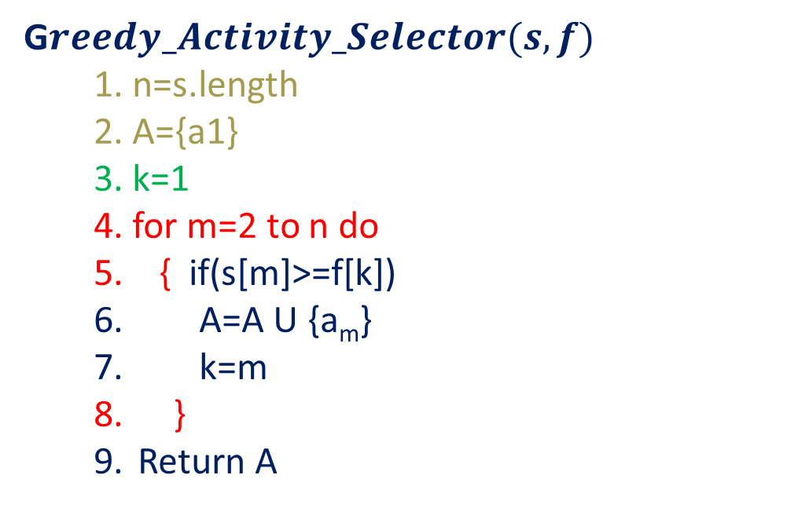
Activity Selection Problem
G$reedy_Activity_Selector(s,f)$
1. n=s.length
2. A={a1}
3. k=1
4. for m=2 to n do
5. { if(s[m]>=f[k])
A=A U {a_{m}}
k=m
}
Return A
1 | 2 | 3 | 4 | 5 | 6 | 7 | 8 | 9 | 10 | 11
s_{i}
1 | 3 | 0 | 5 | 3 | 5 | 6 | 8 | 8 | 2 | 12
4 | 5 | 6 | 7 | 9 | 9 | 10 | 11 | 12 | 14 | 16
f_{i}

Slide 42
Activity Selection Problem
G$reedy_Activity_Selector(s,f)$
1. n=s.length
2. A={a1}
3. k=1
4. for m=2 to n do
5. { if(s[m]>=f[k])
A=A U {a_{m}}
k=m
}
Return A
N=11
1 | 2 | 3 | 4 | 5 | 6 | 7 | 8 | 9 | 10 | 11
s_{i}
1 | 3 | 0 | 5 | 3 | 5 | 6 | 8 | 8 | 2 | 12
4 | 5 | 6 | 7 | 9 | 9 | 10 | 11 | 12 | 14 | 16
f_{i}

Slide 43
Activity Selection Problem
G$reedy_Activity_Selector(s,f)$
1. n=s.length
2. A={a1}
3. k=1
4. for m=2 to n do
5. { if(s[m]>=f[k])
A=A U {a_{m}}
k=m
}
Return A
a_{i}
1 | 2 | 3 | 4 | 5 | 6 | 7 | 8 | 9 | 10 | 11
N=11
s_{i}
1 | 3 | 0 | 5 | 3 | 5 | 6 | 8 | 8 | 2 | 12
4 | 5 | 6 | 7 | 9 | 9 | 10 | 11 | 12 | 14 | 16
A={a1}
f_{i}
K=1
M=2 to 11
M=2 s[2]>=f[1] false m++ i.e. m=3
M=3, k=1 s[3]>=f[1] false m++ i.e. m=4
M=4, k=1 s[4]>=f[1] yes
A={a1, a4}
k=m i.e. k=4 m++ i.e. m=5
M=5, k=4 s[5]>=f[4] false m++ i.e. m=6
M=6, k=4 s[6]>=f[4] false m++ i.e. m=7
M=7, k=4 s[7]>=f[4] false m++ i.e. m=8
M=8, k=4 s[8]>=f[4] yes
A={a1, a4, a8} k=m i.e. k=8 and m=9
M=9, k=8 s[9]>=f[8] false m++ i.e. m=10
M=10, k=8 s[10]>=f[8] false m++ i.e. m=11
M=11, k=8 s[11]>=f[8] yes A={a1, a4, a8, a11)

Slide 44
Activity Selection Problem
G$reedy_Activity_Selector(s,f)$
1. n=s.length
2. A={a1}
3. k=1
4. for m=2 to n do
5. { if(s[m]>=f[k])
A=A U {a_{m}}
k=m
}
Return A
a_{i}
1 | 2 | 3 | 4 | 5 | 6 | 7 | 8 | 9 | 10 | 11
N=11
s_{i}
1 | 3 | 0 | 5 | 3 | 5 | 6 | 8 | 8 | 2 | 12
4 | 5 | 6 | 7 | 9 | 9 | 10 | 11 | 12 | 14 | 16
A={a1}
f_{i}
K=1
M=2 to 11
M=2 s[2]>=f[1] false m++ i.e. m=3
M=3, k=1 s[3]>=f[1] false m++ i.e. m=4
M=4, k=1 s[4]>=f[1] yes
A={a1, a4}
k=m i.e. k=4 m++ i.e. m=5
M=5, k=4 s[5]>=f[4] false m++ i.e. m=6
M=6, k=4 s[6]>=f[4] false m++ i.e. m=7
M=7, k=4 s[7]>=f[4] false m++ i.e. m=8
M=8, k=4 s[8]>=f[4] yes
A={a1, a4, a8} k=m i.e. k=8 and m=9
M=9, k=8 s[9]>=f[8] false m++ i.e. m=10
M=10, k=8 s[10]>=f[8] false m++ i.e. m=11
M=11, k=8 s[11]>=f[8] yes A={a1, a4, a8, a11)

Slide 45
Activity Selection Problem
G$reedy_Activity_Selector(s,f)$
1. n=s.length
2. A={a1}
3. k=1
4. for m=2 to n do
5. { if(s[m]>=f[k])
A=A U {a_{m}}
k=m
}
Return A
a_{i}
1 | 2 | 3 | 4 | 5 | 6 | 7 | 8 | 9 | 10 | 11
N=11
s_{i}
1 | 3 | 0 | 5 | 3 | 5 | 6 | 8 | 8 | 2 | 12
4 | 5 | 6 | 7 | 9 | 9 | 10 | 11 | 12 | 14 | 16
A={a1}
f_{i}
K=1
M=2 to 11
M=2
s[2]>=f[1] false
m++ i.e.
m=3

Slide 46
Activity Selection Problem
G$reedy_Activity_Selector(s,f)$
1. n=s.length
2. A={a1}
3. k=1
4. for m=2 to n do
5. { if(s[m]>=f[k])
A=A U {a_{m}}
k=m
}
Return A
a_{i}
1 | 2 | 3 | 4 | 5 | 6 | 7 | 8 | 9 | 10 | 11
N=11
s_{i}
1 | 3 | 0 | 5 | 3 | 5 | 6 | 8 | 8 | 2 | 12
4 | 5 | 6 | 7 | 9 | 9 | 10 | 11 | 12 | 14 | 16
A={a1}
f_{i}
K=1
M=3 to 11
M=3,
k=1
s[3]>=f[1] false
m++ i.e. m=4

Slide 47
Activity Selection Problem
G$reedy_Activity_Selector(s,f)$
1. n=s.length
2. A={a1}
3. k=1
4. for m=2 to n do
5. { if(s[m]>=f[k])
A=A U {a_{m}}
k=m
}
Return A
a_{i}
1 | 2 | 3 | 4 | 5 | 6 | 7 | 8 | 9 | 10 | 11
N=11
s_{i}
1 | 3 | 0 | 5 | 3 | 5 | 6 | 8 | 8 | 2 | 12
4 | 5 | 6 | 7 | 9 | 9 | 10 | 11 | 12 | 14 | 16
A={a1}
f_{i}
K=1
M=4 to 11
M=4,
k=1
s[4]>=f[1] yes
A={a1, a4}
k=m i.e. k=4 m++ i.e. m=5

Slide 48
Activity Selection Problem
G$reedy_Activity_Selector(s,f)$
1. n=s.length
2. A={a1}
3. k=1
4. for m=2 to n do
5. { if(s[m]>=f[k])
A=A U {a_{m}}
k=m
}
Return A
a_{i}
1 | 2 | 3 | 4 | 5 | 6 | 7 | 8 | 9 | 10 | 11
N=11
s_{i}
1 | 3 | 0 | 5 | 3 | 5 | 6 | 8 | 8 | 2 | 12
4 | 5 | 6 | 7 | 9 | 9 | 10 | 11 | 12 | 14 | 16
A={a1}
f_{i}
K=1
M=5 to 11
M=5,
k=4
s[5]>=f[4] false
m++ i.e. m=6

Slide 49
Activity Selection Problem
G$reedy_Activity_Selector(s,f)$
1. n=s.length
2. A={a1}
3. k=1
4. for m=2 to n do
5. { if(s[m]>=f[k])
A=A U {a_{m}}
k=m
}
Return A
a_{i}
1 | 2 | 3 | 4 | 5 | 6 | 7 | 8 | 9 | 10 | 11
N=11
s_{i}
1 | 3 | 0 | 5 | 3 | 5 | 6 | 8 | 8 | 2 | 12
4 | 5 | 6 | 7 | 9 | 9 | 10 | 11 | 12 | 14 | 16
A={a1}
f_{i}
K=1
M=6 to 11
M=6,
k=4
s[6]>=f[4] false
m++ i.e. m=7

Slide 50
Activity Selection Problem
G$reedy_Activity_Selector(s,f)$
1. n=s.length
2. A={a1}
3. k=1
4. for m=2 to n do
5. { if(s[m]>=f[k])
A=A U {a_{m}}
k=m
}
Return A
a_{i}
1 | 2 | 3 | 4 | 5 | 6 | 7 | 8 | 9 | 10 | 11
N=11
s_{i}
1 | 3 | 0 | 5 | 3 | 5 | 6 | 8 | 8 | 2 | 12
4 | 5 | 6 | 7 | 9 | 9 | 10 | 11 | 12 | 14 | 16
A={a1}
f_{i}
K=1
M=7 to 11
M=7,
k=4
s[7]>=f[4] false
m++ i.e. m=8

Slide 51
Activity Selection Problem
G$reedy_Activity_Selector(s,f)$
1. n=s.length
2. A={a1}
3. k=1
4. for m=2 to n do
5. { if(s[m]>=f[k])
A=A U {a_{m}}
k=m
}
Return A
a_{i}
1 | 2 | 3 | 4 | 5 | 6 | 7 | 8 | 9 | 10 | 11
N=11
s_{i}
1 | 3 | 0 | 5 | 3 | 5 | 6 | 8 | 8 | 2 | 12
4 | 5 | 6 | 7 | 9 | 9 | 10 | 11 | 12 | 14 | 16
A={a1}
f_{i}
K=1
M=8 to 11
M=8,
k=4 s[8]>=f[4] yes
A={a1, a4, a8}
k=m i.e. k=8 and m=9

Slide 52
Activity Selection Problem
G$reedy_Activity_Selector(s,f)$
1. n=s.length
2. A={a1}
3. k=1
4. for m=2 to n do
5. { if(s[m]>=f[k])
A=A U {a_{m}}
k=m
}
Return A
a_{i}
1 | 2 | 3 | 4 | 5 | 6 | 7 | 8 | 9 | 10 | 11
N=11
s_{i}
1 | 3 | 0 | 5 | 3 | 5 | 6 | 8 | 8 | 2 | 12
4 | 5 | 6 | 7 | 9 | 9 | 10 | 11 | 12 | 14 | 16
A={a1}
f_{i}
K=1
M=9 to 11
M=9,
k=8
s[9]>=f[8] false
m++ i.e. m=10

Slide 53
Activity Selection Problem
G$reedy_Activity_Selector(s,f)$
1. n=s.length
2. A={a1}
3. k=1
4. for m=2 to n do
5. { if(s[m]>=f[k])
A=A U {a_{m}}
k=m
}
Return A
a_{i}
1 | 2 | 3 | 4 | 5 | 6 | 7 | 8 | 9 | 10 | 11
N=11
s_{i}
1 | 3 | 0 | 5 | 3 | 5 | 6 | 8 | 8 | 2 | 12
4 | 5 | 6 | 7 | 9 | 9 | 10 | 11 | 12 | 14 | 16
A={a1}
f_{i}
K=1
M=10 to 11
M=10,
k=8
s[10]>=f[8] false
m++ i.e. m=11

Slide 54
Activity Selection Problem
G$reedy_Activity_Selector(s,f)$
1. n=s.length
2. A={a1}
3. k=1
4. for m=2 to n do
5. { if(s[m]>=f[k])
A=A U {a_{m}}
k=m
}
Return A
a_{i}
1 | 2 | 3 | 4 | 5 | 6 | 7 | 8 | 9 | 10 | 11
N=11
s_{i}
1 | 3 | 0 | 5 | 3 | 5 | 6 | 8 | 8 | 2 | 12
4 | 5 | 6 | 7 | 9 | 9 | 10 | 11 | 12 | 14 | 16
A={a1}
f_{i}
K=1
M=11 to 11
M=11,
k=8
s[11]>=f[8] yes
A={a1, a4, a8, a11)

Slide 55
Activity Selection Problem
G$reedy_Activity_Selector(s,f)$
1. n=s.length
2. A={a1}
3. k=1
4. for m=2 to n do
5. { if(s[m]>=f[k])
A=A U {a_{m}}
k=m
}
Return A
N=11
A={a1}
K=1
M=11 to 11
Complexity of Fractional Knapsack
?

Slide 56
Thank You

